Slide 1


Slide 2
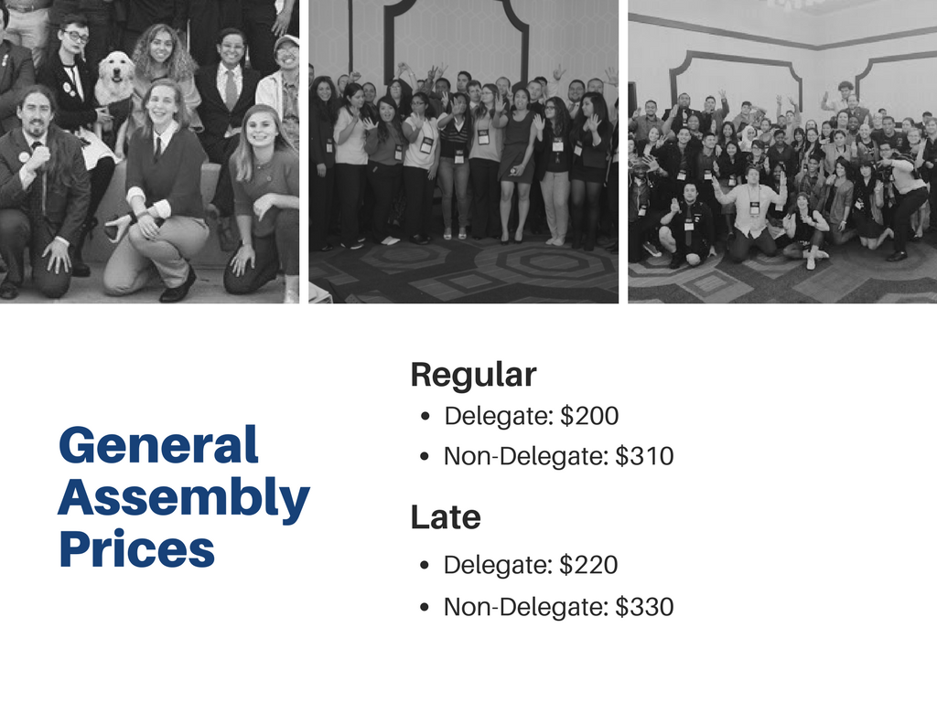
Registration Cost
Registration Fees - Until on April 21, 2017 11:59 PM
Registration for Students and Advisors: $310.00
Registration for Delegates: $200.00
Registration Fees - After April 22, 2017 12:00 AM
Registration for Students and Advisors: $330.00
Registration for Delegates: $220.00
* Pending Final Contract approval

Slide 3

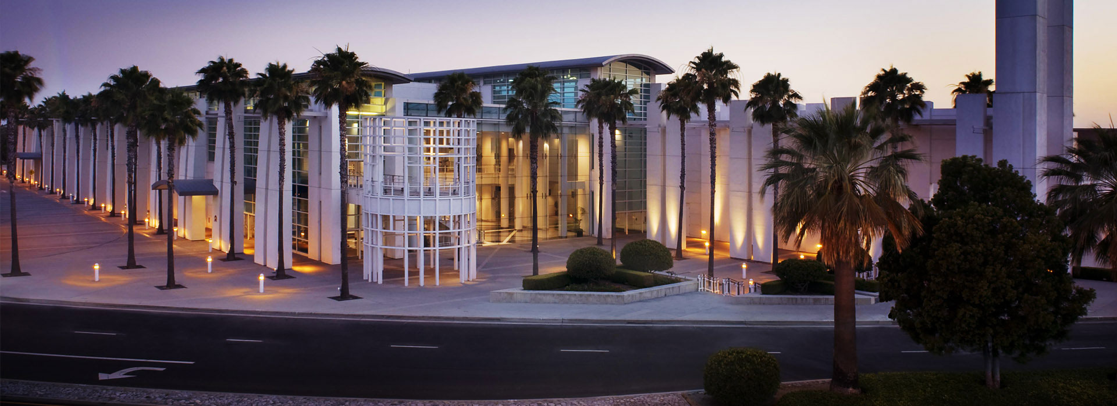

Slide 4


Slide 5
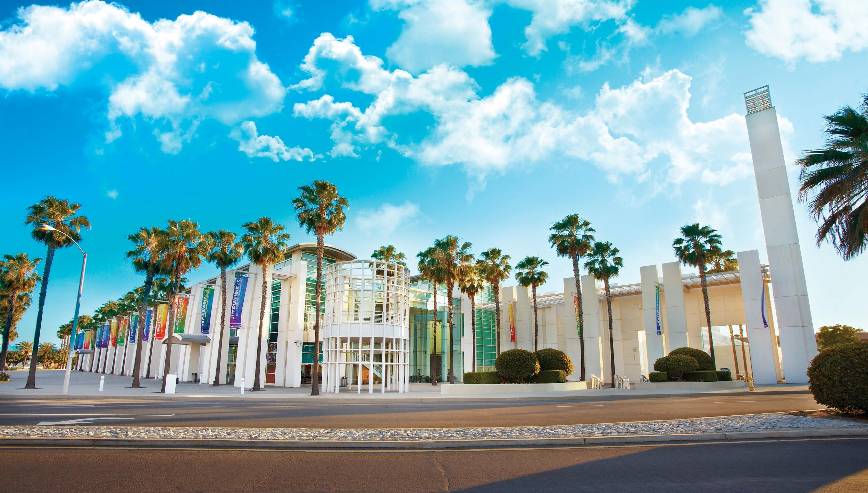


Slide 6

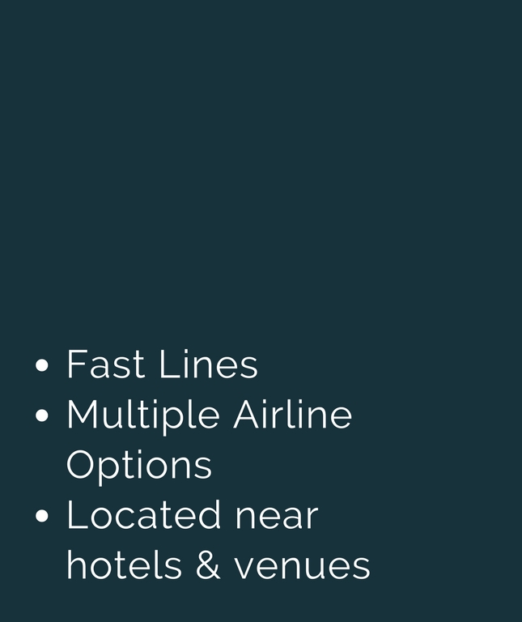

Slide 7



Slide 8

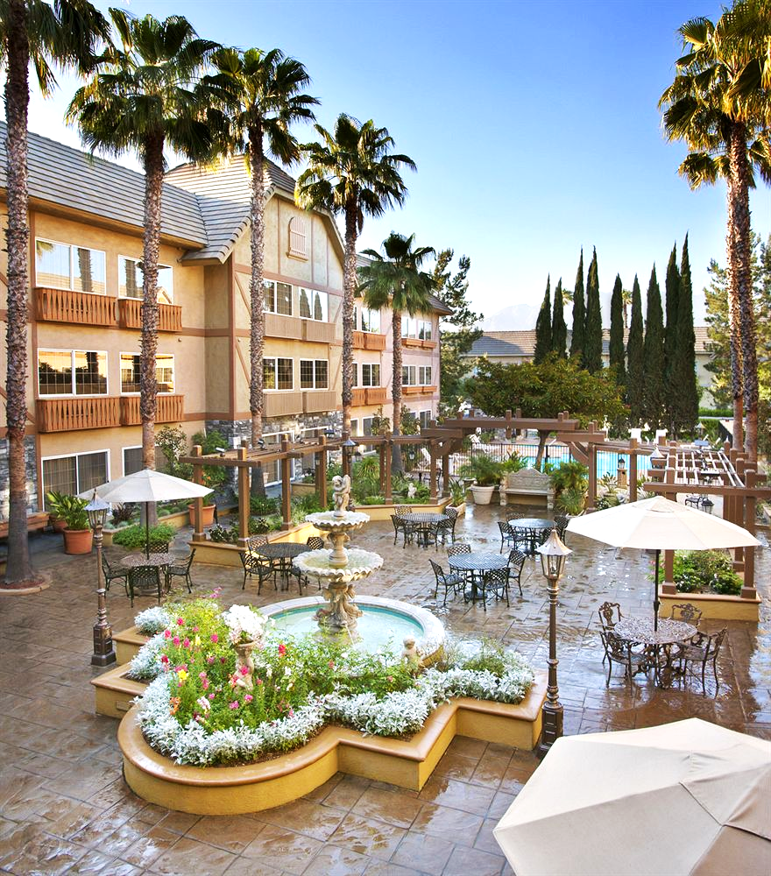


Slide 9
Courtesy Blocks
Hotel Info
Ontario DoubleTree Hotel
http://doubletree.hilton.com/en/dt/groups/personalized/O/ONTO-DT-CCC-20170505/index.jhtml?WT.mc_id=POG
Cut-off Date: April 14, 2017 or until block is full
BEST WESTERN PLUS InnSuites Ontario
10 rooms on hold at $99.00. Call sales directly and mention that you are with Spring 2017 General Assembly.
909.466.9600
Other Hotels in the Area
http://arestravel.com/9283_hotel-list.html

Slide 10



It's my resolutions packet and I want it now.
Dissemination of Active Resolutions
Resolution Submission Deadline
March 1st
The Unamended Resolutions Packet is Disseminated
March 6th

Slide 11



It's my resolutions packet and I want it now.
General Assembly
Amendments to the Resolutions are Due
March 31st
The Packet with Amendments is Released
April 5th
Attend

Slide 12
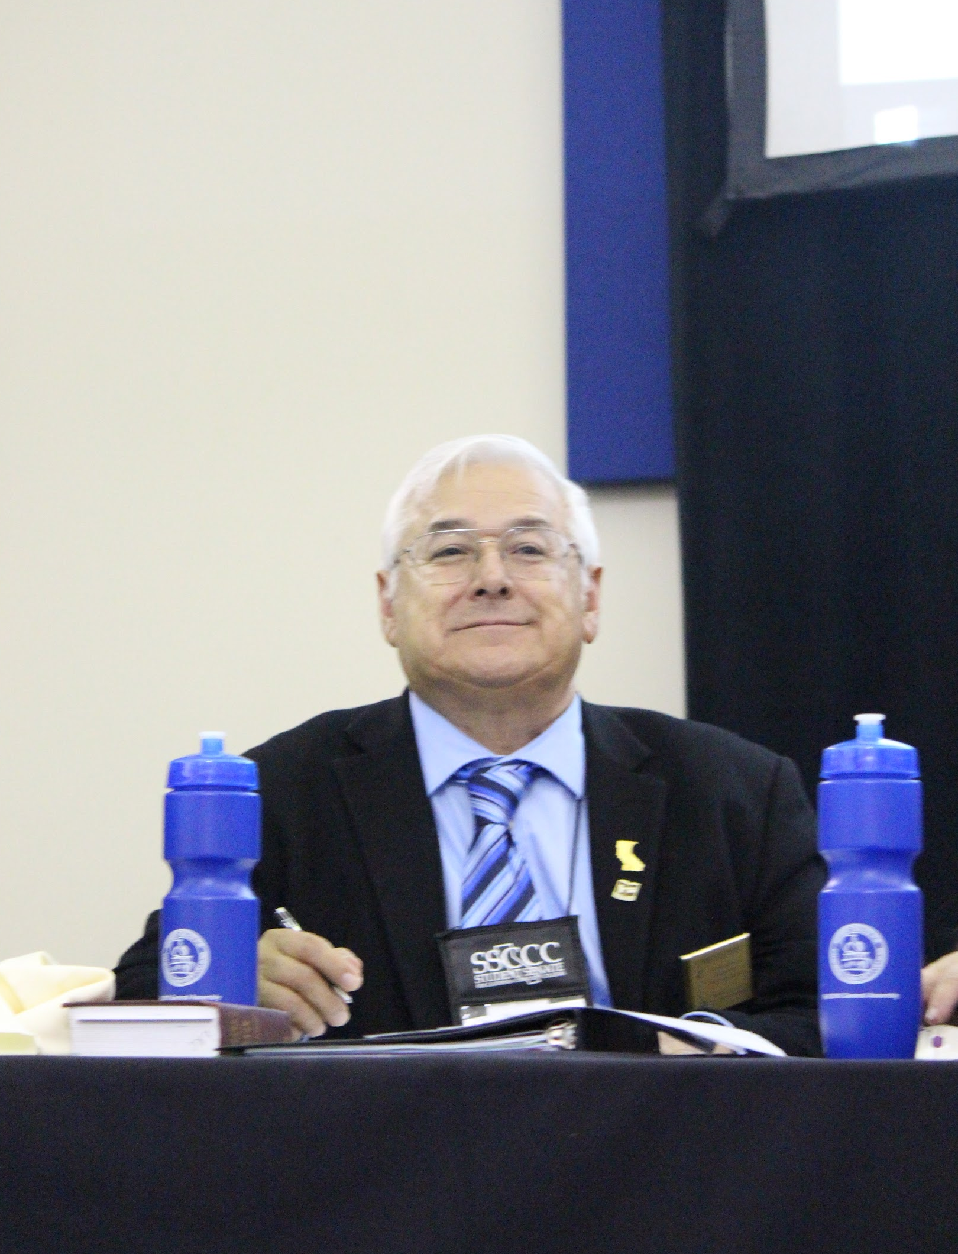

Don't Be Caught off Guard By The Rules!
Review the Resolutions Procedures
Submit Amendments on Time
Read the Agenda
Use your Delegate Motion Cheat Sheet
Attend the Pre-Delegate Trainings

Slide 13
Schedule;
Schedule
Schedule
https://docs.google.com/a/studentsenateccc.org/spreadsheets/d/1K4IVoKmmRKtVqOWHpT3MiLtDXe-tJqx-1fARKoH-ifU/edit?usp=sharing

Slide 14
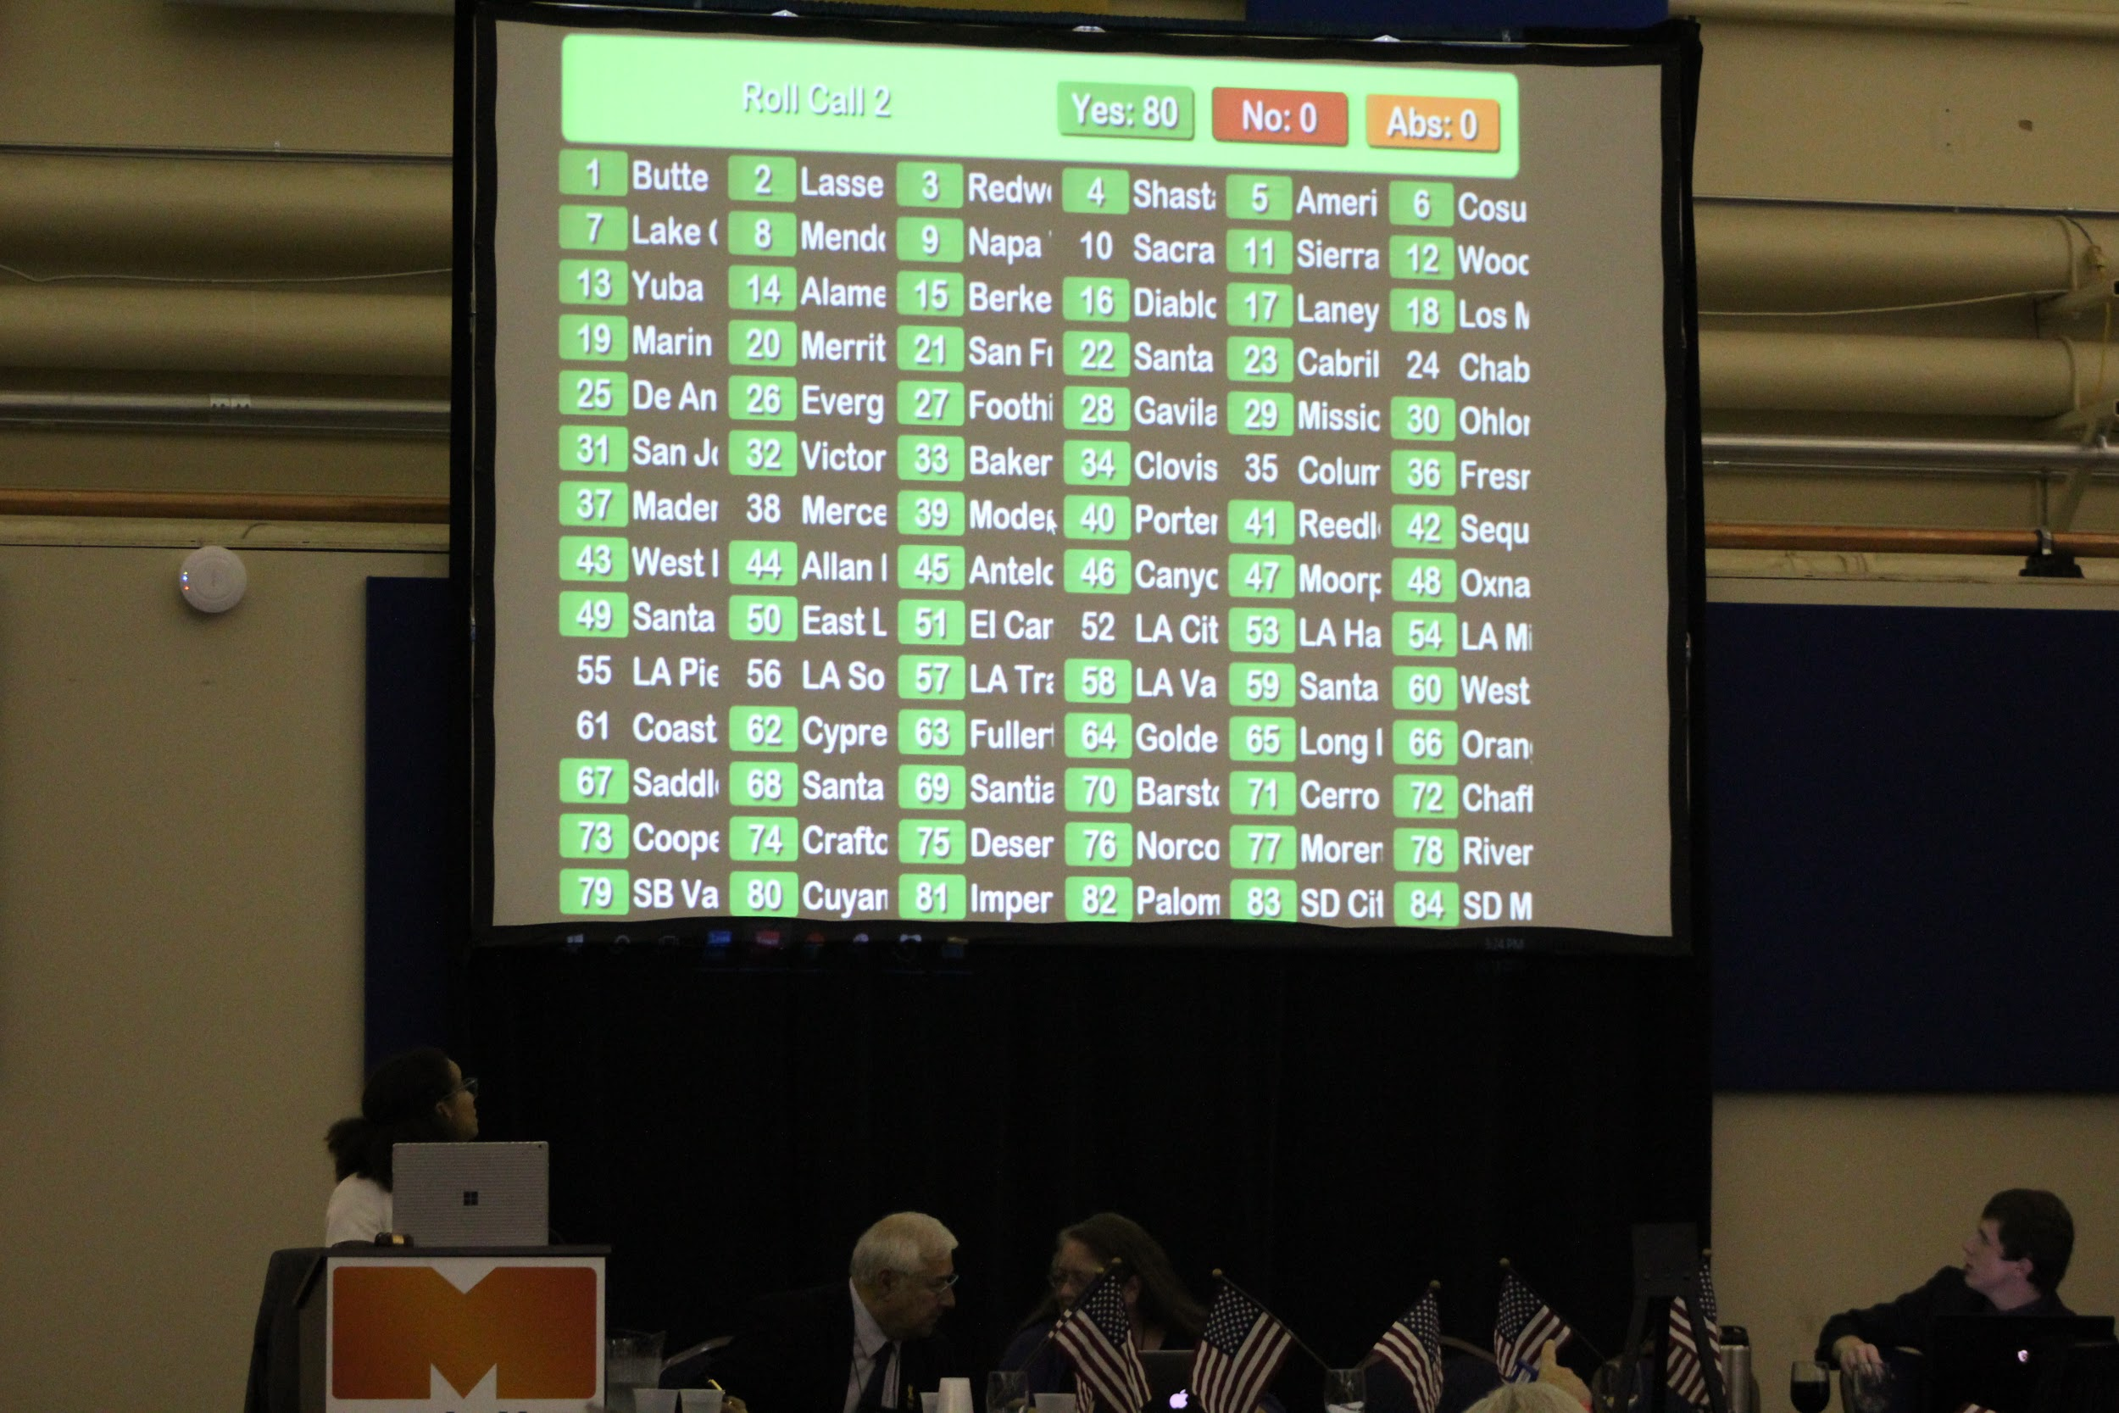
What to Expect?
Over 14 Breakouts on everything from leadership and shared governance, to parli pro training.
Over 90 other colleges.
A wealth of opportunities to connect with other student leaders.
To make a statewide difference.
An opportunity to have your views challenged and expanded.

Slide 15
Dias
PRO
Parli
CON
Delegate Assembly
Voting Area
Members of the Public

Slide 16
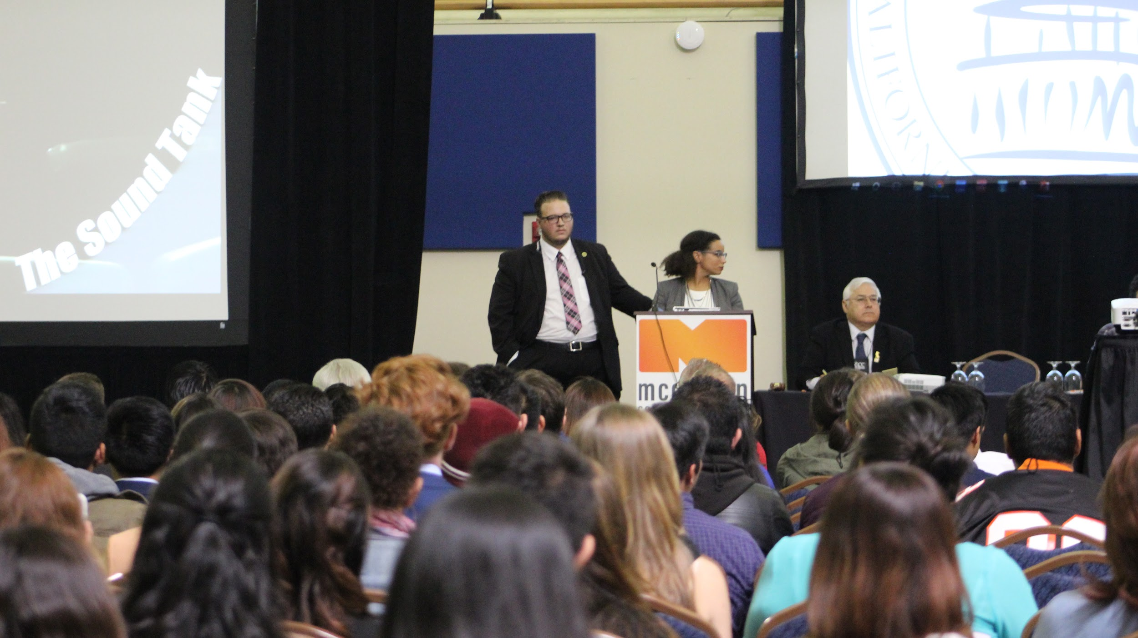
How not to be “THAT” College

Slide 17
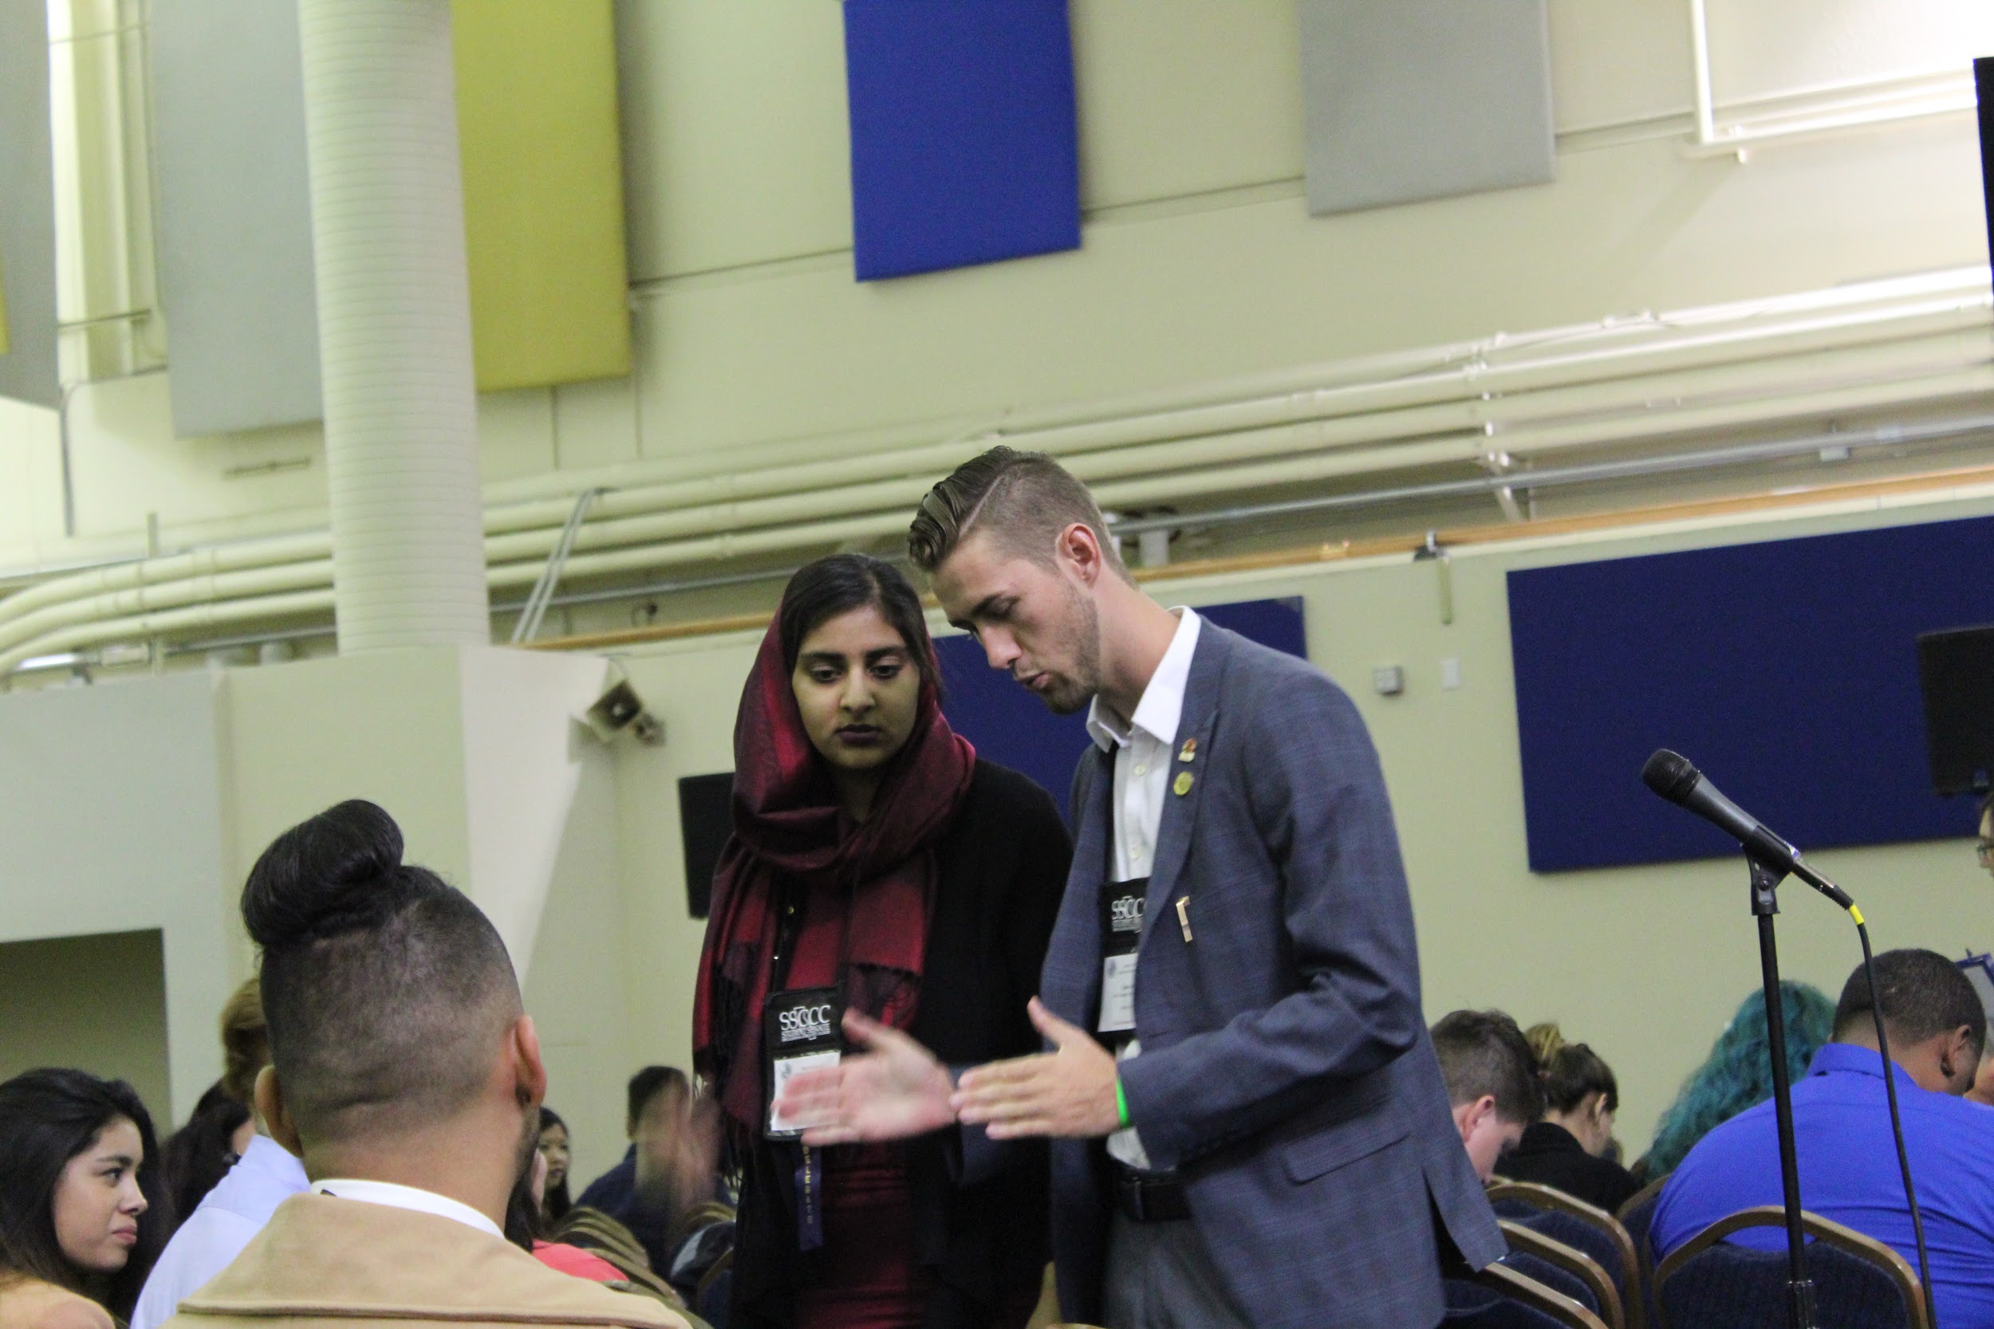
Read Ahead of Time
Represent Well
Ask Questions
Review the Packet before you get to GA
Read the procedures
Review Robert’s Rules of Order Convention Procedures
Review the Schedule
Maintain Proper Decorum
  No Yelling
  No arguing with people from your seat, We Have Pro and Con Mics for that
  Wait to be recognized
Know the motion you want to make before you get to the Parli-Mic
Only one person may represent a college at a time
Only a delegate can object
Do not speak after a motion unless you want to second it, wait for debate if it is second’d
If you are confused or need help; ask for it. We are happy to help!

Slide 18
Upcoming Opportunities to Get Involved in the
2017 Spring General Assembly Planning
January - February 2017
Budget will be Discussed
Keynotes will be Discussed
Budget will be Approved
April 2017
Program and Agenda will be Released
March 2017
Breakouts, Theme, and Keynotes will be Finalized
May 2017
All the logistics will be taken care of (Technology, Program, Vendors)

Slide 19
Register Today
2017 Spring General Assembly
https://www.regonline.com/builder/site/Default.aspx?EventID=1953261&ct=t

Slide 20
Upcoming Opportunities to Get Involved in the
2017 Spring General Assembly Planning
Suggest Breakouts!
https://goo.gl/forms/leEtkxxmhDVuI5QC3

Slide 21
Upcoming Opportunities to Get Involved in the
2017 Spring General Assembly Planning
Pre-Delegate Trainings
Attend!

Slide 22
Upcoming Opportunities to Get Involved in the
2017 Spring General Assembly Planning
Suggest a Keynote Speaker
Events@studentsenateccc.org

Slide 23
Have Questions?
Have Questions?
Gerald E. Sirotnak Events Chair
Larry Kelly Resolutions Chair
For all General Assembly Questions
Events@StudentSenateCCC.org
For Resolutions Questions
EVP@StudentSenateCCC.org

